Slide 1
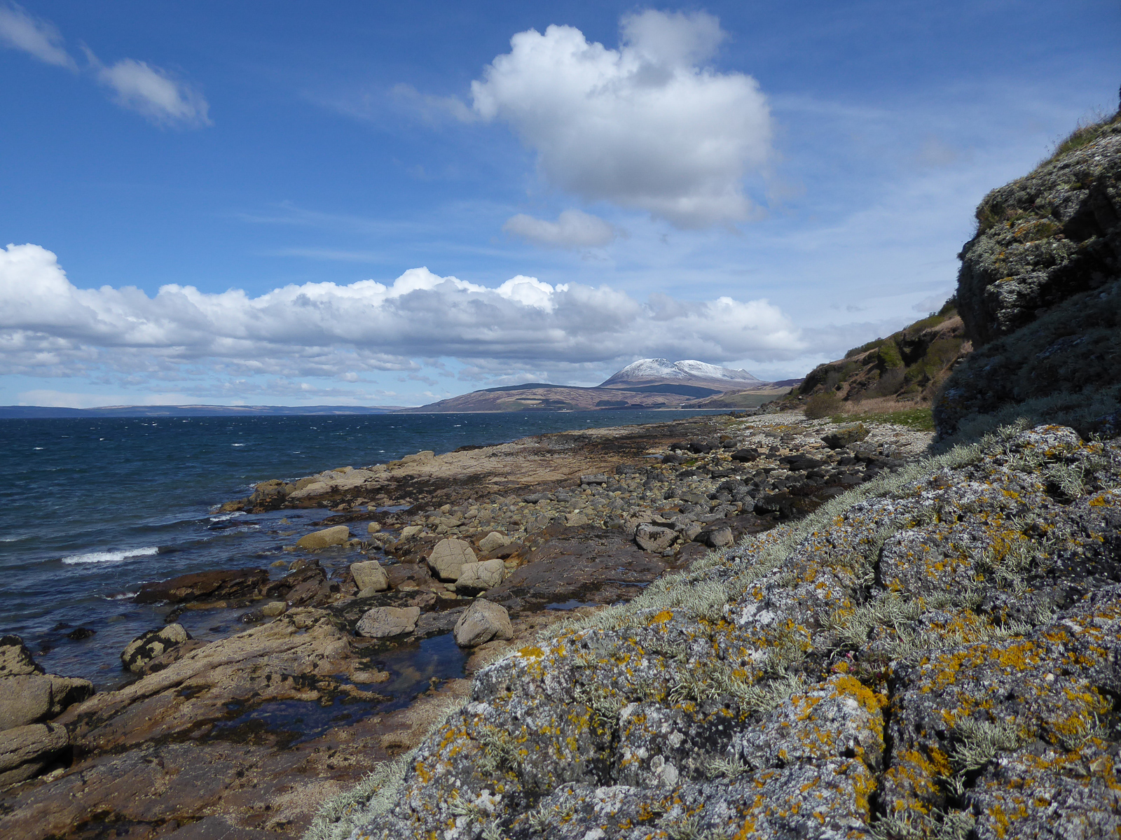
Rocky Shore Ecology
Notes:
Starter activity- students complete the plankton card sort- match the plankton larvae with its adult form. This gets students thinking about the diversity of life on the rocky shore and the kinds of organisms we may find there. See Plankton card sort PDF file and Plankton card sort answers PDF file.

Slide 2
Introduction to Rocky shore Investigation
This lesson:
This session will focus on the ecology of our rocky shores. As an island nation with one of the longest coastlines of any European nation, these are incredibly important habitats to us. Including our islands, we have nearly 20,000 miles of coastline in the UK, with much of this being rocky shore habitat.
Objectives:
Understand the environmental gradients present in the intertidal zone
Identify and classify some common species found in rocky shore habitat
Describe different adaptations that allow animals and algae to survive here
Experience a fieldwork session and observe key sampling techniques
Collect data on the abundance and distribution of species on the rocky shore

Slide 3
Rocky Shore Ecosystems…
Mainly marine species
Very diverse ecosystems
So why do so many marine species live on the rocky shore rather than further out and deeper down?
Notes:
Rocky shore are very diverse ecosystem with most species living on the rocky shore being marine species. Since it is much easier for a marine species to live in the ocean why are so many of them living on the rocky shore?
Discuss what it means to be marine. Need salt water for feeding (eg. Filter feeding), to extract oxygen for respiration, reproduction (release gametes for external fertilisation), competition (to exploit a new niche), predation. Adaptations to cope with different conditions.

Slide 4
Rocky Shore Ecosystems…
Rocky shores are highly productive
Increased light due to shallow water.
Increased mineral ions washed down by rivers or brought in by tides
Increased photosynthesis
Increased Production
So there are clear advantages to living on the rocky shore.
However, the organisms living there have to cope with a number of challenges relating to tides.
Interpret the tidal graphs on the handout to find out more about tides and how they effect the organisms living on the rocky shore.
Notes:
Answer: Highly productive
Student to Fill in flow diagram on handout.
Increased light compared to further out at sea due to shallow water. Increased Mineral ions rather than further out at sea Where do these come from? Washed down by rivers or brought in by tides.
Students to interpret the tide graphs and read the information on the abiotic and biotic factors on the rocky shore. Using this information answer the questions and fill in the HO.

Slide 5
How do variables change with height up the shore?
Splash
THE HIGHER UP THE SHORE AN ORGANISM LIVES THE LONGER “THE PERIOD OF EMERSION”
Upper
Can you think of TWO ABIOTIC and TWO BIOTIC factors which will change with vertical height up a rocky shore?
Middle
Lower
Sublittoral
…and where would each factor be most of a problem?
Lower, Middle or Upper?
Notes:
Different abiotic and biotic factors will have bigger impacts on different parts of the shore. Some factors will have a larger impact in the upper shore, while others may have a greater influence in the lower or middle shore.
Students brainstorm different abiotic and biotic conditions that will change with vertical height up the shore. Where will each factor be most of a problem?

Slide 6
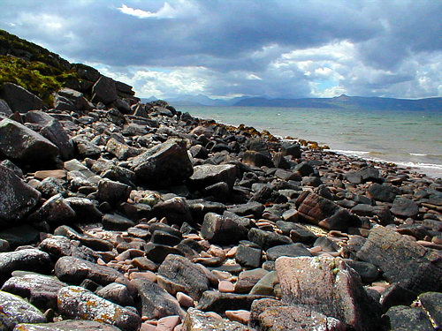
THE HIGHER UP THE SHORE AN ORGANISM LIVES THE LONGER “THE PERIOD OF EMERSION”
DESICCATION
RISK
Birds
TEMP.
VARIATION
PREDATORS
SALINITY VARIATION
WAVE ACTION
LARVAL
DISPERSION
Fish Crabs
OXYGEN VARIATION
LOW LIGHT
COMPETITION
ABIOTIC FACTORS
BIOTIC FACTORS
SEA

Slide 7
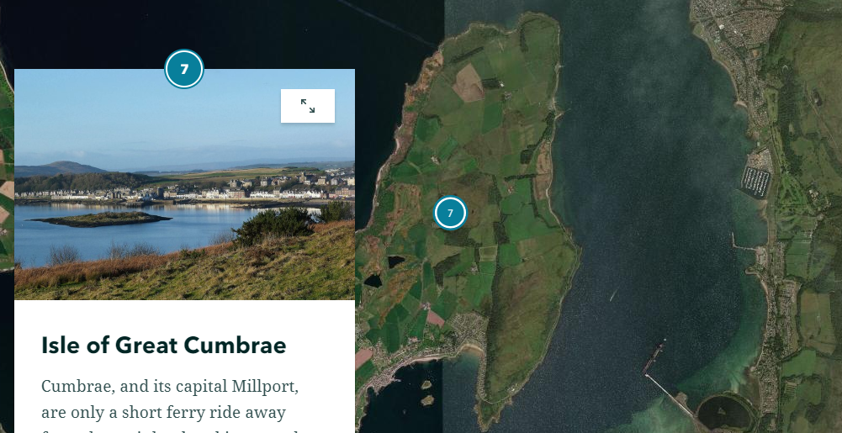
Story Map
Explore the Story Map and record key points from your research on your handout.
https://storymaps.arcgis.com/stories/a2ae3ecc7f60445ea96b89738a87af78

Slide 8
State the hypothesis
An investigation into species distribution and abundance with height on shore.
Hypothesis:
Independent variable?
Dependent variable?
What controls do we need to consider?
Notes:
If you were doing an experiment to investigate the effect of temperature on rate of enzyme controlled reaction what would you control? pH, substrate concentration, enzyme concentration, time etc.
So if we are looking at a rocky shore, what variables will we need to control here?
Hypothesis: species distribution and abundance changes with height on shore.
IV: Height on shore
DV: species distribution and abundance
Sampling strategy: interrupted belt transect. (unless doing stratified!)
What size quadrat? Needs to be appropriate for the scale of the organism being studied. Large enough to be representative of the range of species at each sample site.

Slide 9
Controlling variables
Variable | How to control
Microhabitat
Aspect
Geology
Time of year
Exposure
Notes:
Microhabitat- e.g. in and out of a rockpool

