Slide 1
Coral Live 2021
GCSE / A-LEVEL | AGES 14-18
Introduction to the coral ecosystem

Slide 2
Introduction to the coral ecosystem
Learning outcomes
The location and distribution of warm water coral reef ecosystems
The distinctive features of coral reefs and the environmental conditions associated with reef development to include water temperature, acidity, salinity and algal blooms
The processes and relationships that link biotic and abiotic aspects of the ecosystem to include nutrient cycling and the interdependence of climate, soil, water, plants, animals and humans

Slide 3
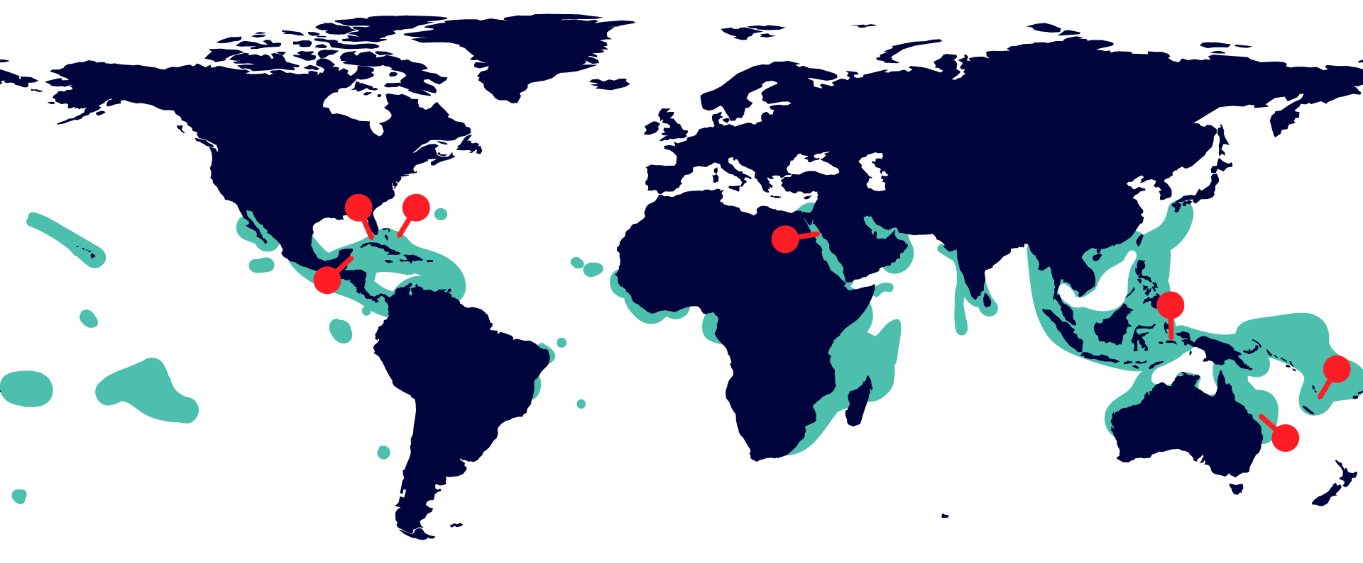
Introduction to the coral ecosystem
Location and distribution of coral reefs
Florida Reef
Andros Coral Reef
Red Sea Reef
Coral Triangle
Mesoamerican Barrier Reef
New Caledonia Barrier Reef
Great Barrier Reef

Slide 4
Introduction to the coral ecosystem
Further reading
What are coral reefs and why are they important?
VIEW SUBJECT UPDATE

Slide 5
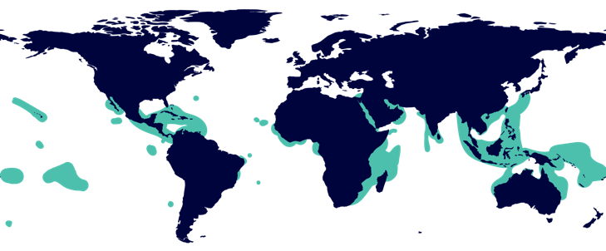
Introduction to the coral ecosystem
What affects the location and distribution of coral reefs?
Polys prefer waters between 23ºC and 29ºC, but up to 40ºC for short periods.
Very salty water (32 to 42 parts per thousand).
Clear, shallow water so they can get energy from sunlight.
Mostly found between the 30⁰ north and south latitudes.
They don’t like water that is below 18ºC.
Most coral reefs are located near the shore.
Normally, not muddy or turbid water as this can smother the reef.
Generally confined to tropical and semitropical waters.

Slide 6
Introduction to the coral ecosystem
Further reading
Which countries have coral reef cover?
VIEW SUBJECT UPDATE

Slide 7
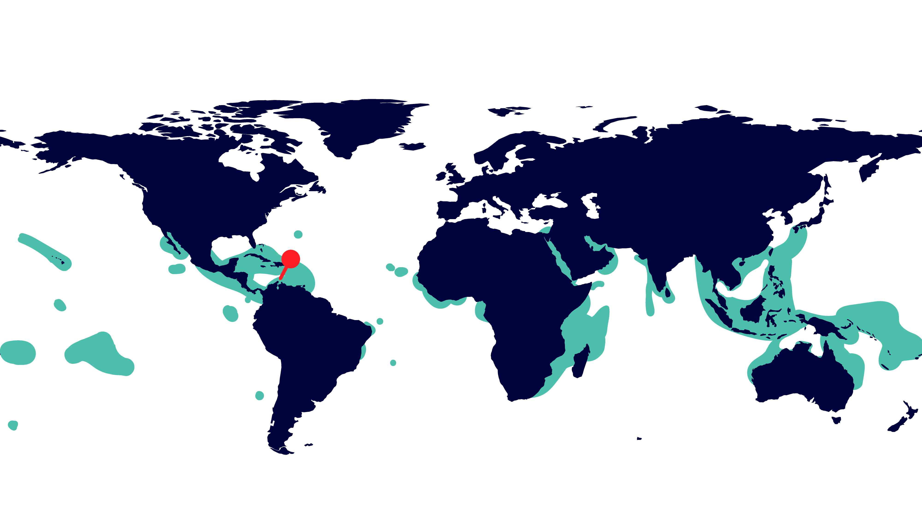
Introduction to the coral ecosystem
Curaçao

Slide 8
Introduction to the coral ecosystem
Curaçao’s climate

Slide 9
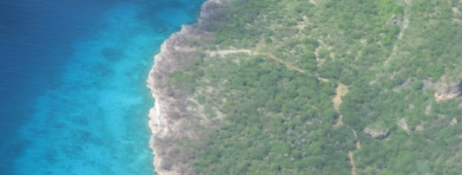
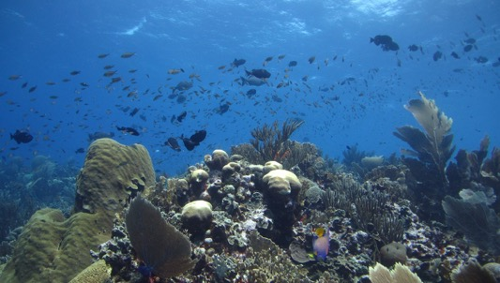
Introduction to the coral ecosystem
Fringing reefs of Curaçao
The reefs of Curaçao are part of the ocean biome. Curaçao is surrounded by fringing reef, with most coral cover on the west facing shore, sheltered from rougher sea conditions.
You can see how there is a 50 to 100 metre sandy reef flat reaching out from shore. Around 8 metres depth, the reef flat starts to slope down to depths of 60 to 90 metres. Then there is a sharp drop down to depths of over 1,500 metres just a mile offshore.

Slide 10
Introduction to the coral ecosystem
Further reading
How are coral reefs formed?
VIEW SUBJECT UPDATE

Slide 11
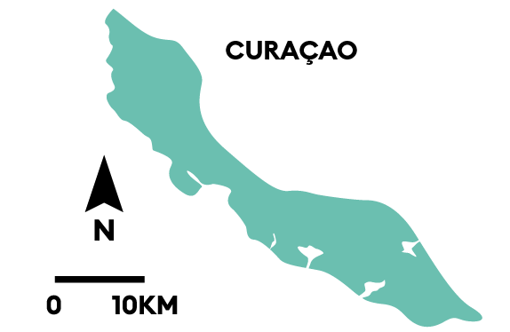
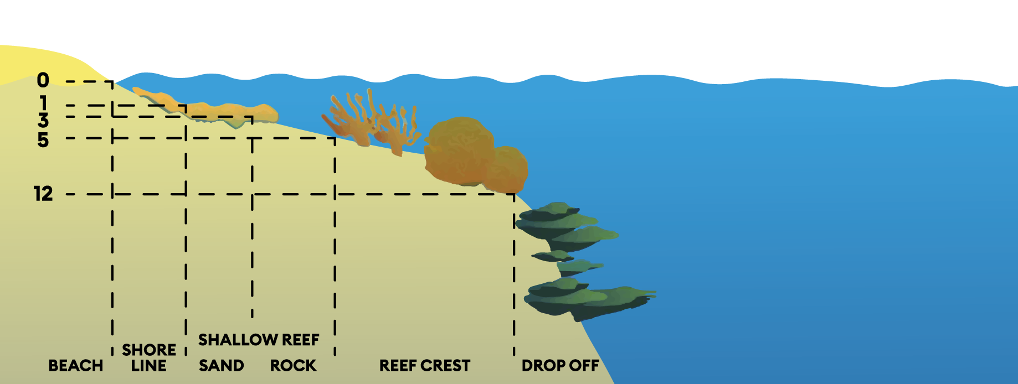
Introduction to the coral ecosystem
Zones on the Curaçao reef
Notes:
w

Slide 12
Introduction to the coral ecosystem
Biodiversity on the coral reef
Coral reefs are the most biodiverse ecosystem on the planet. They cover less than 0.1% of the ocean, and yet support over 25% of all marine life.
The biodiversity of the reef includes the habitat forming corals and sponges, that together create the 3D reefscape. This habitat provides a home to fish species, such as sharks, clownfish and parrotfish. Visitors to the reef can spot also spot invertebrates, such as sea stars, sea cucumbers, sea slugs, and anemones.

Slide 13
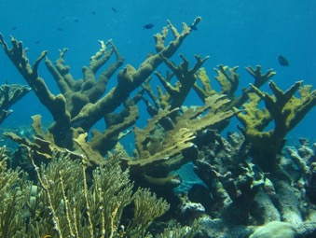
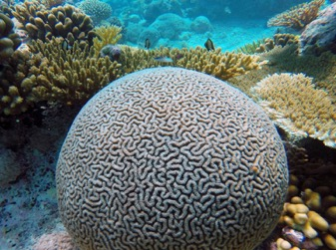
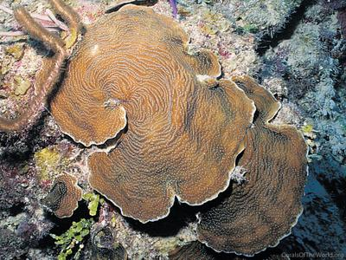
Introduction to the coral ecosystem
Coral species in Curaçao
Curaçao is home to about 65 coral species. These range from the iconic branching elkhorn coral, to the easy to identify brain coral. Star corals, pillar corals can also be found. At greater depths, Lamarck’s sheet coral dominates.
Elkhorn coral
Brain coral
Lamarck’s sheet coral

Slide 14
Introduction to the coral ecosystem
Fish species in Curaçao
There are 358 fish species found on Curaçao. Different species of fish include parrotfish, barracuda, scorpionfish, eagle rays, horse-eye jacks, and moray eels.
Sharks were abundant in the waters off Curaçao but are now more of a rarity.
And you wouldn’t find Nemo on the reefs of Curaçao. Clownfish only live in the Indian and Pacific oceans.

Slide 15
Introduction to the coral ecosystem
Invertebrate species in Curaçao
Hundreds of invertebrate species also make up life on the coral reef. Aside from corals and sponges, these also other octopus, Christmas tree worms, sea slugs, feather duster worms, sea anemones and a host of other invertebrate species on the reefs.

Slide 16
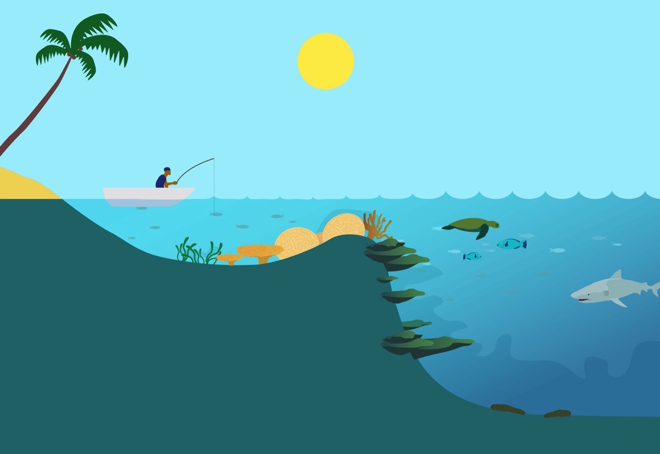
Introduction to the coral ecosystem
Sunlight – coral polyps need access to sunlight to grow, gaining sugars from algae inside their tissue. Other producers also need access to sunlight.
Temperature - corals need a stable temperature in the range, of 18C - 30C
Inverterbrate species in Curaçao
Calcium carbonate – coral reefs take available calcium and carbonate ions from the water to create their structures.
Consumers can be herbivores getting energy from eating plants and algae.
Producers, e.g. plankton, zooxanthellae, seagrass and seaweed create energy through photosynthesis.
Nutrients – nitrates and phosphates are scarce and highly recycled within the coral reef ecosystem.
Consumers can be carnivores getting energy from eating other animals.
Detritivores include bacteria and sea cucumbers feeding on dead and decaying matter.
Abiotic and biotic factors

Slide 17
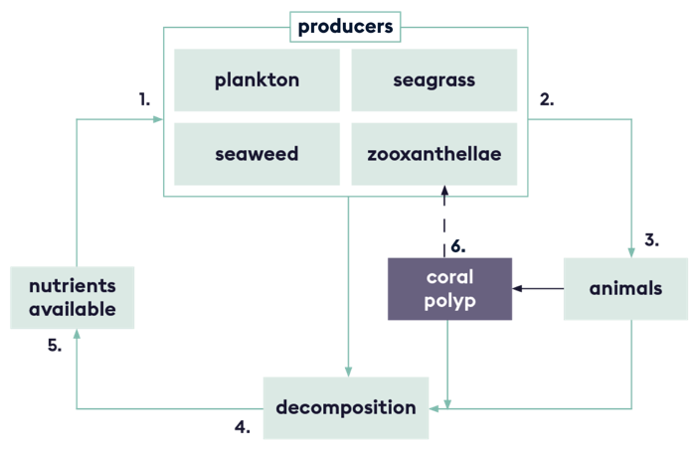
Introduction to the coral ecosystem
Nutrient cycling on the reef
Producers absorb nutrients from the water column and sediment.
There are a wide variety of producers on the reef, including plants (e.g. seagrass), microalgae (e.g. phytoplankton), macroalgae (e.g. seaweed) and algae inside coral tissue (zooxanthellae).
Animals eat plants and other animals.
Decomposers such as bacteria break down waste and dead ‘plants’ and animals.
Nutrients are made available from waste in the water column and released from decomposition in the sediment.
Symbiotic relationships also play a role in the nutrient cycle. Sugars from zooxanthellae pass straight to the coral polyp and nutrients pass the other way.

Slide 18
Introduction to the coral ecosystem
Types of questions we can ask
Level 1 | Level 2
Who/What/Where/When/How/ Describe/ What is? | Retell...in your own words... What is the difference between..?
Level 3 | Level 4
Do you know of an instance where... Why is _____ significant? How is ______ related to______? | How does ____ compare with ____? What evidence do you have for______?

Slide 19
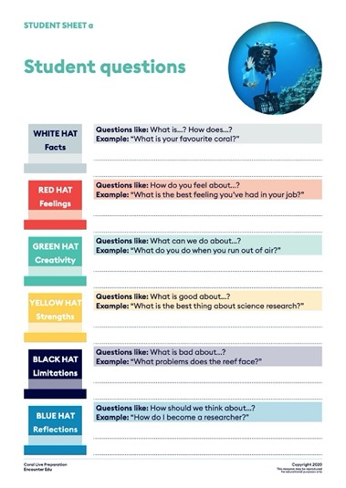
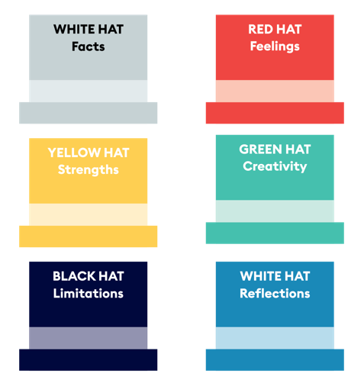
Introduction to the coral ecosystem
Thinking hat questions

Slide 20
Introduction to the coral ecosystem
Image Credits
Slide | Title | Attribution
1 | Healthy reef | By CARMABI
4 | Underwater scene | By XL Catlin Seaview Survey
6 | Satellite imagery | By NASA
9 | Curaçao | By CARMABI
10 | Satellite image | By NASA
12-15 | All images | By CARMABI

