Slide 1
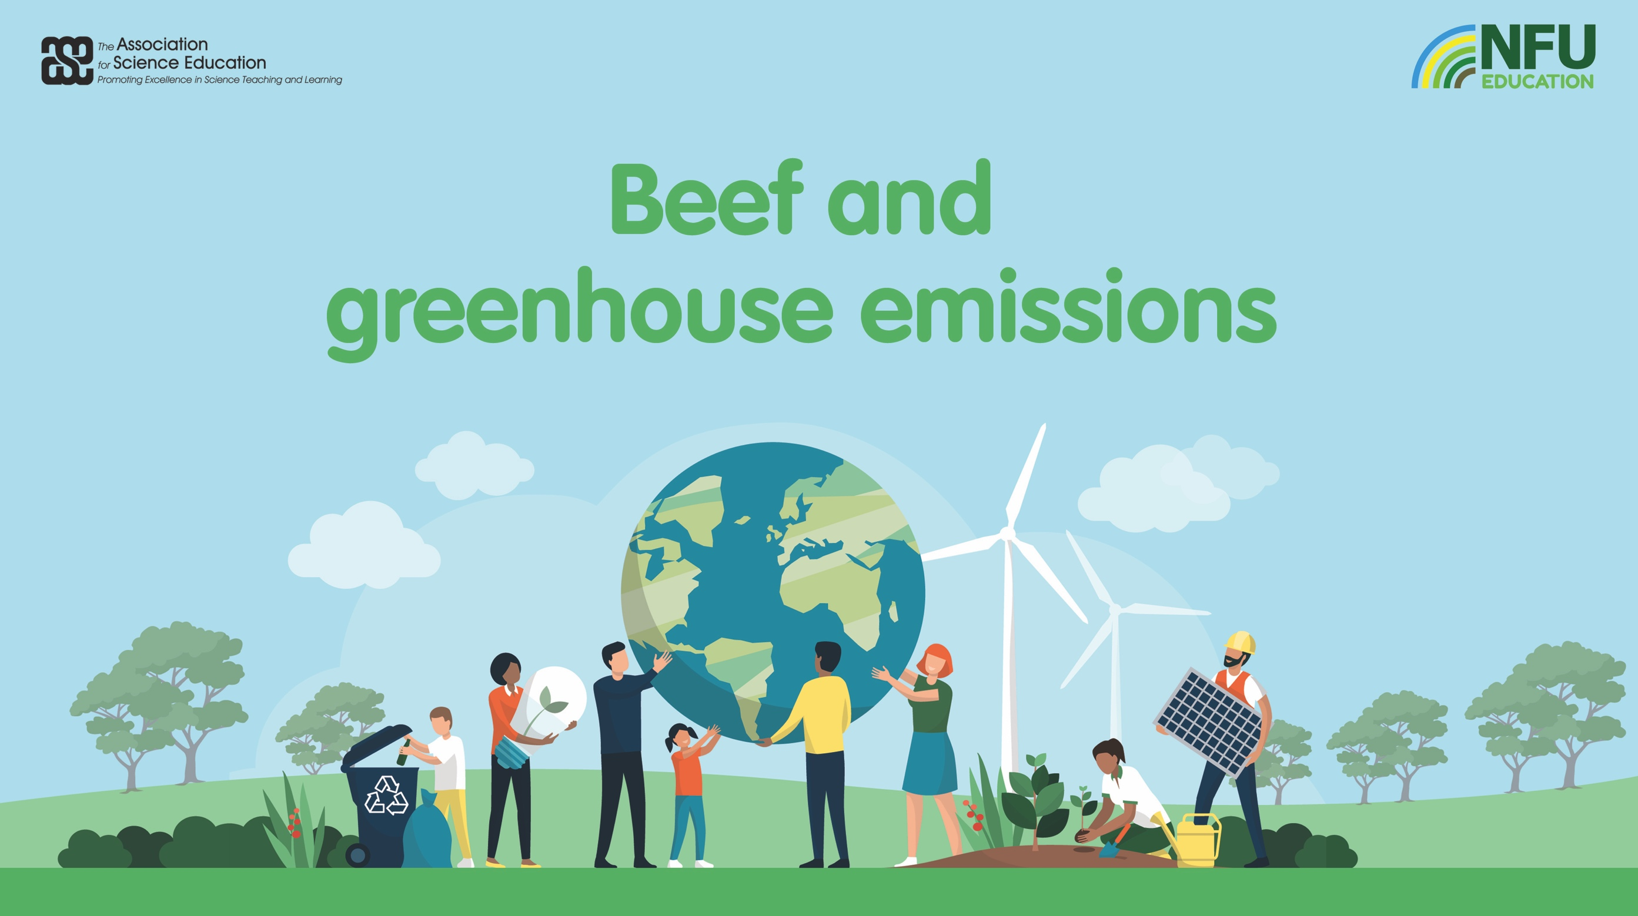

Slide 2
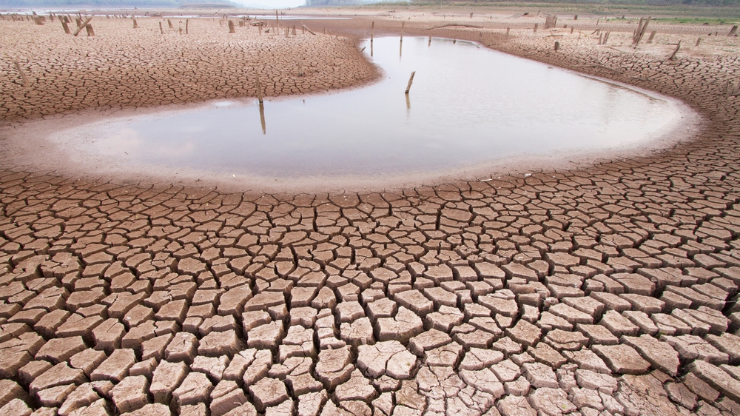
Climate change is causing severe drought in some countries…

Slide 3
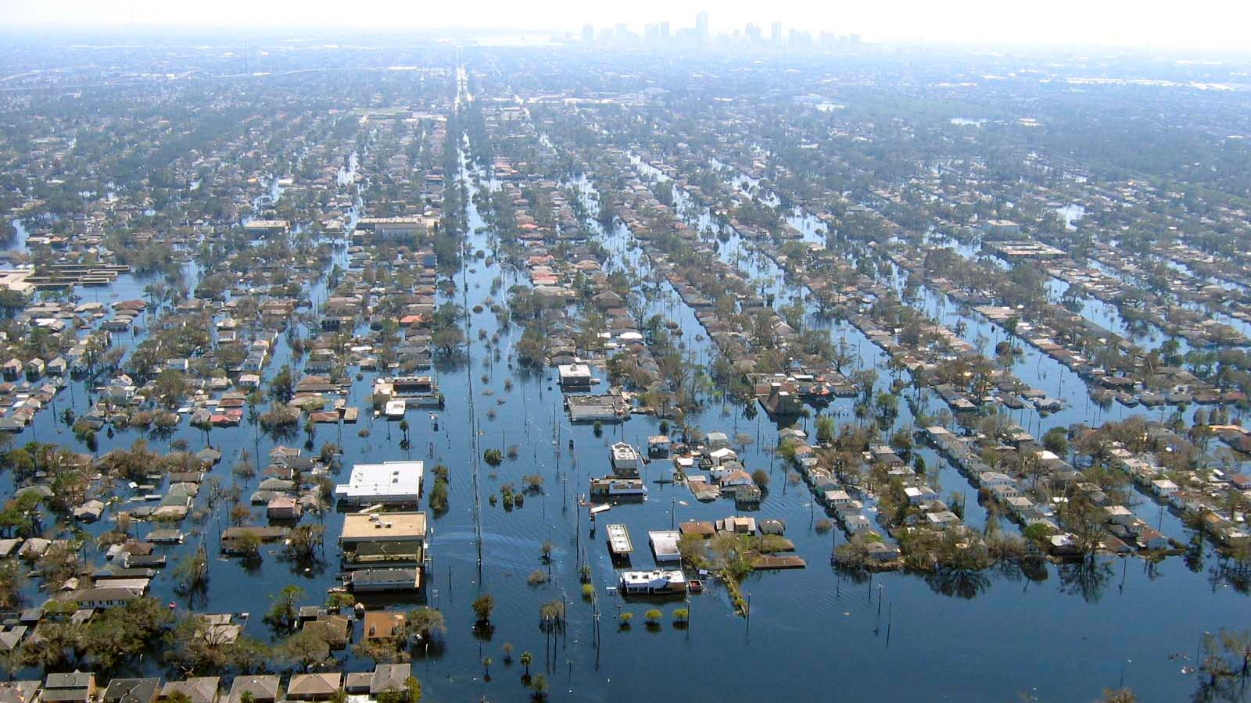
…and is causing extreme weather events in others.

Slide 4
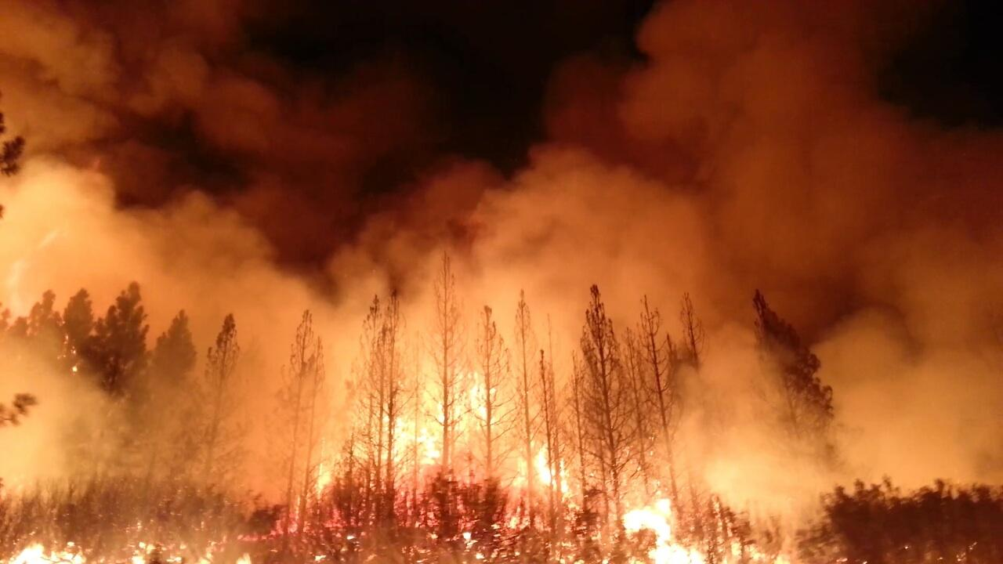
Slash and burn of rainforests releases millions of tonnes of carbon dioxide into the atmosphere…

Slide 5
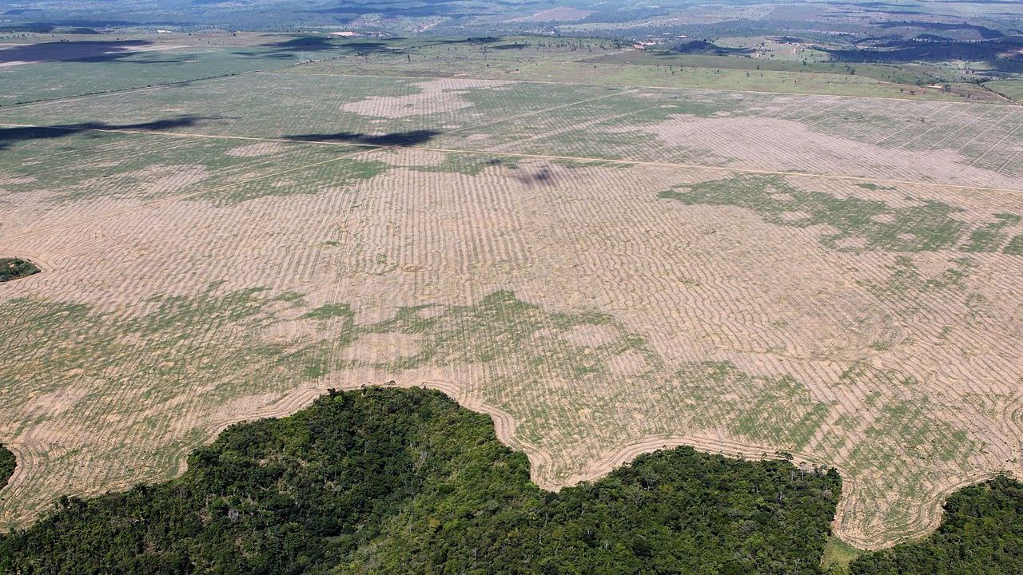
…and the trees are no longer there to remove carbon dioxide from the air by photosynthesis.

Slide 6
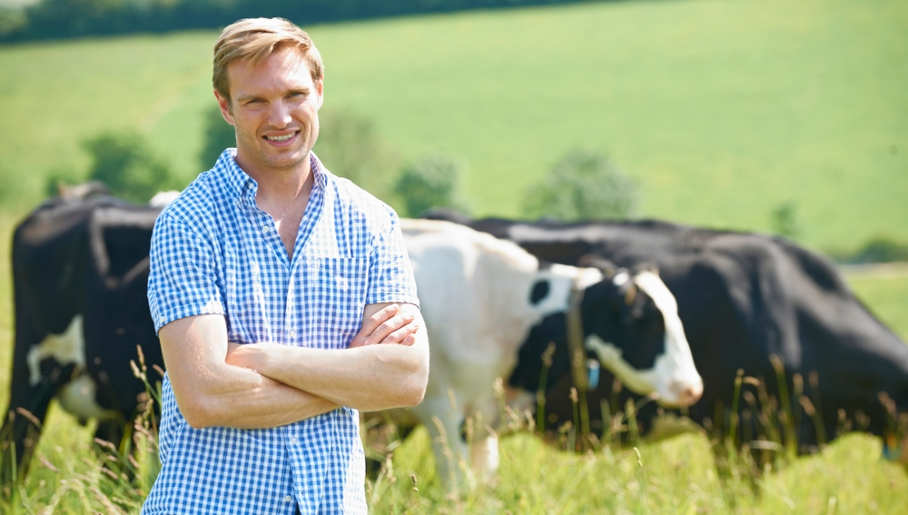
British livestock have amongst the highest welfare standards…

Slide 7
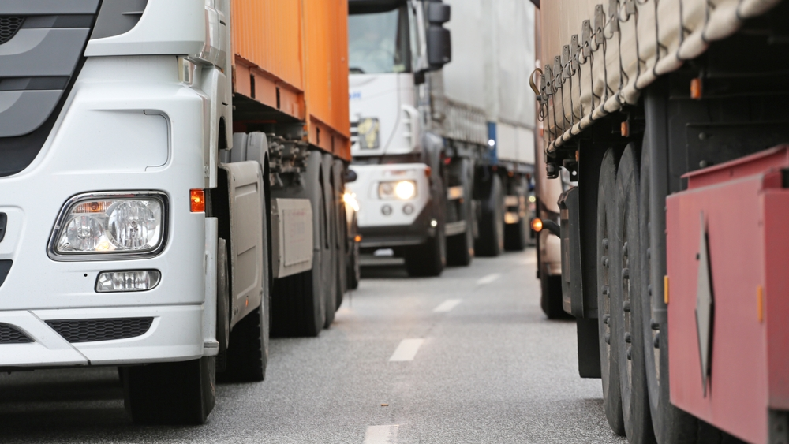
…and locally produced food reduces carbon emissions from transporting food across Planet Earth.

Slide 8
Some food processors and fast-food chains buy their beef from the cheapest source, but it may cost the environment!

